Slide 1
Artificial Intelligence
School of computer science
Huazhong university of science and technology
冯琪

Slide 2
Lecture 3 Beyond Classical Search

Slide 3
Topics
Local Search Algorithms and Optimization Problems
Local Search in Continuous Spaces
Searching with Nondeterministic Actions
Searching with Partial Observations
Online Search Agents and Unknown Environments

Slide 4
The feature of the problem in this lecture
We do not ask the problem addressed in this lecture with
observable, deterministic, known environments
the path to the goal is irrelevant to the solution.
Many examples with these feature，such as
8-queens problem,
integrated-circuit design,
factory-floor layout,
job-shop scheduling,
Telecommunications network optimizationuting

Slide 5
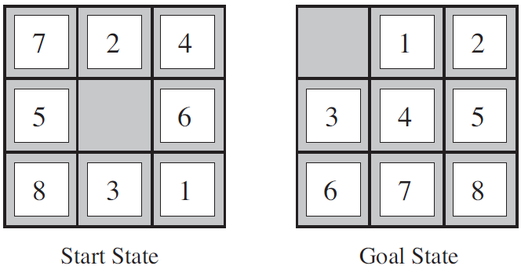
Quiz
Design a A* Search
drawing out the search graph with open table and close table
You only need to write 6 steps

Slide 6
Local Search
Introduction to Artificial Intelligence – Lecture 03

Slide 7
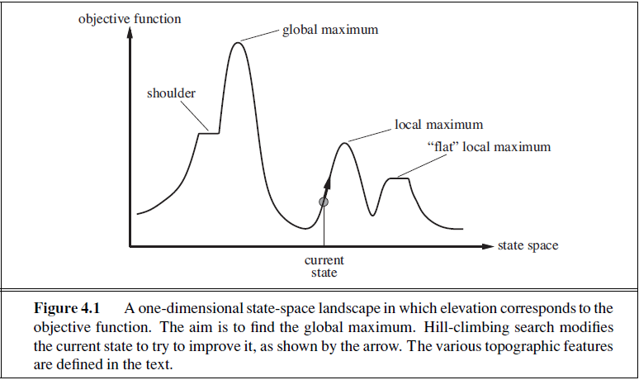
Local Search – Hill Climbing
it is also called greedy local search

Slide 8
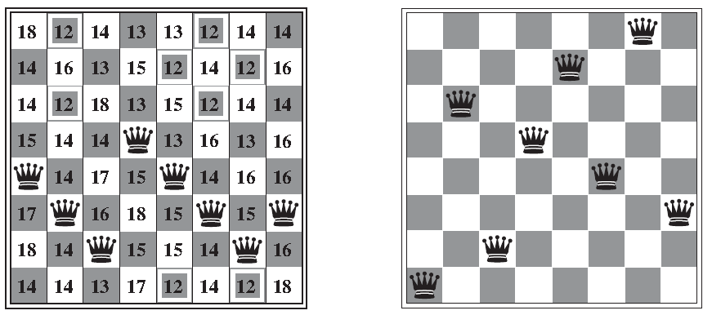
An 8-queens – Using Hill Climbing
each state: 8 queens , one per column.
The successor: state generated by moving a single queen to another square in the same column
each state has 8×7=56 successors
The cost function h = the number of pairs of queens that are attacking each other
Initial state final state
h=17 h=1

Slide 9
Local Search Family
To avoid local maximum
Simulated Annealing
Genetic Algorithm

Slide 10
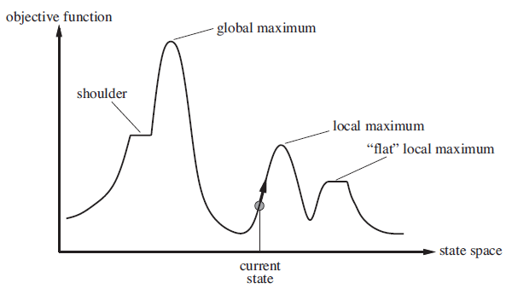
Analysis : hill-climbing
A hill-climbing algorithm
It never makes “downhill” moves toward states with lower value
it is guaranteed to be incomplete, because it can get stuck on a local maximum.

Slide 11
Analysis : a random walk
a purely random walk
It moving to a successor chosen uniformly at random from the set of successors
It is complete but extremely inefficient.
Move to any point with uniform probability

Slide 12
combining hill climbing with a random walk
It seems reasonable to try to combine hill climbing with a random walk
It yields both efficiency and completeness.
Simulated annealing is such an algorithem

Slide 13
Simulated Annealing
annealing is the process in metallurgy
used to temper or harden metals and glass by heating them to a high temperature and then gradually cooling them, thus allowing the material to reach a low energy crystalline state.
Simulated annealing
it combines hill climbing with a random walk
Move with a probability

Slide 14
Simulated Annealing Algorithm
current ←MAKE-NODE(INITIAL-STATE)
for t =1 to ∞ do
T ←schedule(t)
if T =0 then return current
next ←a randomly selected successor of current
ΔE ←next.VALUE – current.VALUE
if ΔE > 0 then
current ←next
else
current ←next only with a probability e^{ΔE/T}
Move with a probability

Slide 15
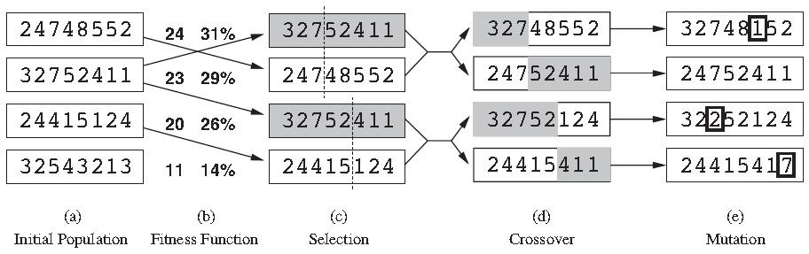
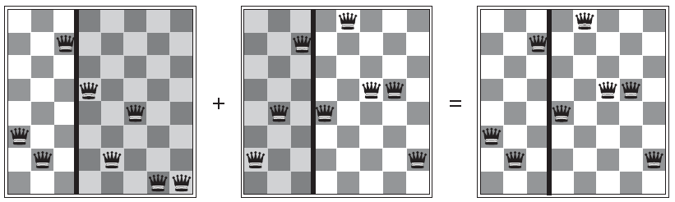
Genetic Algorithm
It begin with a set of k randomly generated states, called the initial population.
Each individual, is represented as a string called coding
Design a fitness function, for example
the number of nonattacking pairs of queens
corresponding to the first two parents and the first offspring of crossover

Slide 16
Genetic Algorithm
The production of the next generation of states
(Evolution)
Selection
Crossover
Mutation
corresponding to the first two parents and the first offspring of crossover

Slide 17
Genetic Algorithm – an example
f(x) = x·sin(10π·x)+1.0
To find an X to maximize f(X)
x ∈[-1，2]

Slide 18
Genetic Algorithm – Step 1 coding
x ∈[-1，2] ( Discretization )
0000000000 represents -1
0000000001 represents -1+δ
1111111111 represents 2
δ=1 / (2¹⁰-1)
10: number of bits

Slide 19
Genetic Algorithm – Step 2 Initialization
Now we have 1024 (2¹⁰) possible solutions
0000000000
0000000001
…
1111111111
Initialization
Randomly select 50, we call this set of solution first generation of population

Slide 20
Genetic Algorithm – fitness function
To measure which one is better
In this example, we let the f(X) is the fitness function
X 1010011000 101101100000
The one makes f(X) is larger will be kept

Slide 21
Genetic Algorithm – Step 3 Evolution
Selection
Select the best 50% individual from the previous generation of population into the next generation
Crossover
Randomly select two individuals, exchange part of the code
Mutation
For Crossover and Mutation, the better individual is kept in the next generation
P1 1000111000
P2 1101100100
P1’ 1000100100
P2’ 1101111000
1010011000
101101100000

Slide 22
Genetic Algorithm – Step 4 Termination
Terminate if
The current generation is, for example, 200th or
A better solution can not be achieved
Optimal solution
The best X among the current generation

Slide 23
Searching with Uncertainty
Introduction to Artificial Intelligence – Lecture 03

Slide 24
SEARCHING WITH NONDETERMINISTIC ACTIONS
the environment is either partially observable or nondeterministic (or both),
Percepts become useful.

Slide 25
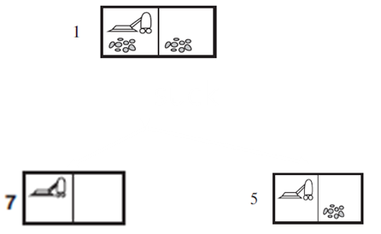

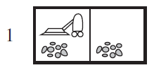
Example：Erratic vacuum world
The Suck action works as follows
When applied to a dirty square the action cleans the square and sometimes cleans up dirt in an adjacent square too
When applied to a clean square the action sometimes deposits dirt on the carpet
suck

Slide 26

Example：Erratic vacuum world
to generalize the notion of a transition model from stable vacuum world
For stable vacuum : it outputs a single state,
For erratic vacuum : it outputs a set of possible states.
to generalize the notion of a solution ：
For stable vacuum : [Suck, [Right, Suck] ]
For erratic vacuum : [Suck, if State = 5 then [Right, Suck] else [] ]
The form of the solution is a tree rather than a sequence.
suck
suck

Slide 27
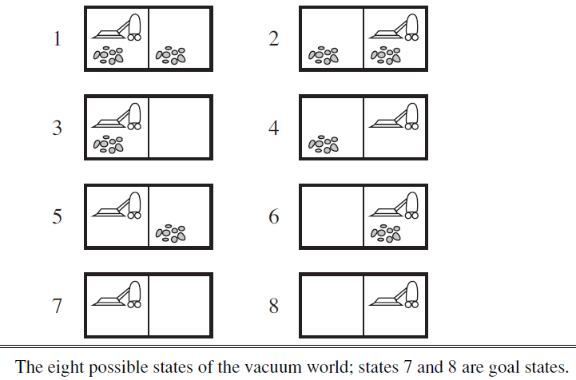
States of the Erratic vacuum world

Slide 28
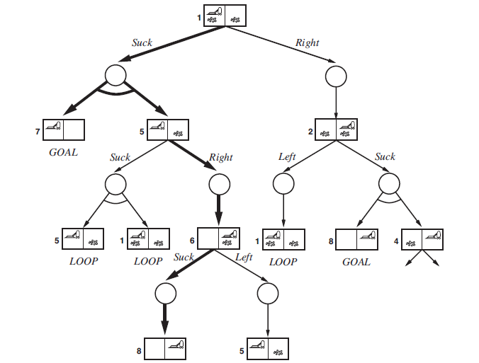
And – Or search tree
How to describe the solution of erratic vacuum world
Using a and-or tree :
How to find for a solution of erratic vacuum world
search on the and-or tree

Slide 29
a recursive, depth-ﬁrst algorithm for AND–OR graph search
function AND-OR-GRAPH-SEARCH(problem) returns a conditional plan, or failure
OR-SEARCH(problem.INITIAL-STATE, problem, [] )
comments
a conditional plan
it reaches a goal state from current state in all circumstances.
The notation [x | l]
the list formed by adding object x to the front of list l.

Slide 30
OR – search function
function OR-SEARCH(state,problem,path) returns a conditional plan, or failure
if problem.GOAL-TEST(state) then return the empty plan
if state is on path then return failure
for each action in problem.ACTIONS(state) do
plan ←AND SEARCH(RESULTS(state,action), problem, [state | path]) if plan ≠ failure then return [action | plan]
return failure

Slide 31
AND-SEARCH function
function AND-SEARCH(states,problem,path) returns a conditional plan, or failure
for each s_{i} in states do
plan_{i} ←OR-SEARCH(si,problem,path)
if plan_{i} = failure then return failure
return [if s₁ then plan₁ else if s₂ then plan₂ else ...if s_{n−1} then plan_{n−1} else plan_{n}]

Slide 32
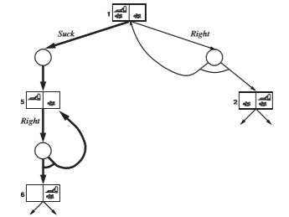
the slippery vacuum world
For the slippery vacuum world
It is identical to the ordinary (non-erratic) vacuum world
except that movement actions sometimes fail
leaving the agent in the same location.
Sometimes cycle might appear on and-or graph

Slide 33
the slippery vacuum world
For example, moving Right in state 1 leads to the state set {1, 2}.
there are no longer any acyclic solutions from state 1,
AND-OR-GRAPH-SEARCH would return with failure.
There is a cyclic solution
It is to keep trying Right until it works
Thus, cyclic solution is
[Suck, while State =5 do Right] .

Slide 34
Searching with no observations
When the agent’s percepts provide no information at all,
we have what is called a sensorless problem
There is a example of sensorless problem for the vacuum world
if we assume that the agent knows the geography of its world, but doesn’t know its location or the distribution of dirt.
its initial state could be any element of the set {1, 2, 3, 4, 5, 6, 7, 8}.
if it tries the action Right. This will cause it to be in one of the states {2, 4, 6, 8}

Slide 35
initial States of a vacuum cleaner with sensorless
its initial state could be any element of the set {1, 2, 3, 4, 5, 6, 7, 8}.

Slide 36
a action Right on a vacuum cleaner with sensorless
if it tries the action Right, it will become to one of the states {2, 4, 6, 8}

Slide 37
Solving sensorless problems
To solve sensorless problems
we search in the space of belief states rather than physical states
the underlying physical problem P ：
ACTIONS_{P},RESULT_{P},GOAL-TEST_{P}, and STEP-COST_{P}.
we can deﬁne the corresponding sensorless problem
by using the space of belief states

Slide 38
defining the corresponding sensorless problem
We will define a sensorless problem through these components
Belief states:
Initial state:
Actions:
Transition model:
Goal test:
Path cost:
Consider a sensorless version of the vacuum world

Slide 39
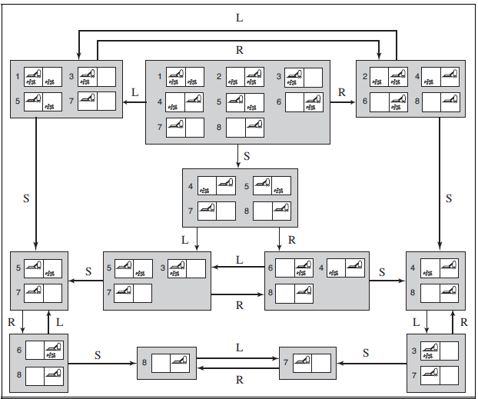
Belief states
Belief states:
The entire belief-state space contains every possible set of physical states.
If P has N states, then the sensorless problem has up to 2^{N} states,
many may be unreachable from the initial state.

Slide 40
Initial state
Initial state:
Typically the set of all states in P,
although in some cases the agent will have more knowledge than this.

Slide 41

Actions
Actions:
Suppose the agent is in belief state b={s1,s2}, but ACTIONS_{P}(s1) ≠ ACTIONS_{P}(s2);
the agent is unsure of which actions are legal.
If we assume that illegal actions have no effect on the environment,
ACTIONS(b)=$\bigcup_{s∈b}{ACTIONS(s)}$

Slide 42

Transition model
With nondeterminism, we have
b’ = RESULT(b,a)={s’ : s’ ∈ RESULTS_{P}(s,a) and s ∈ b} = ACTIONS(b)=$\bigcup_{s∈b}{ACTIONS(s,a)}$
which may be larger than b.
The process of generating the new belief state after the action is called the prediction step;

Slide 43
Goal test
The agent wants a plan that is sure to work
It means that a belief state satisﬁes the goal only if all the physical states in it satisfy GOAL-TEST_{P}.
The agent may accidentally achieve the goal earlier, but it won’t know that it has done so.

Slide 44
Path cost
If the same action can have different costs in different states
the cost of taking an action in a given belief state could be one of several values.

Slide 45
a sensorless version of the vacuum world——an example.
the agent knows the geography of its world, but doesn’t know its location or the distribution of dirt.
its initial state could be any element of the set {1,2,3,4,5,6,7,8}.
consider what happens if it tries the action Right.
This will cause it to be in one of the states {2,4,6,8}—---
the agent now has more information!
Furthermore, the action sequence [Right,Suck] will always end up in one of the states {4,8}.
Finally, the sequence [Right,Suck,Left,Suck] is guaranteed to reach the goal state 7 no matter what the start state.
space of belief states

Slide 46
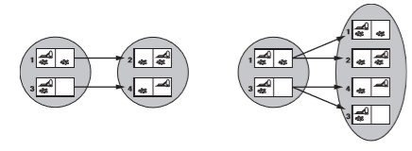
the prediction step
The action is deterministic
The action is nondeterministic

Slide 47
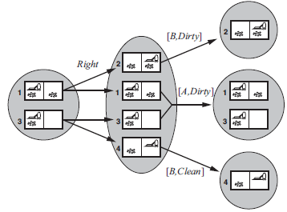
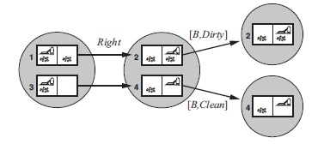
Searching with partial observations
The action is nondeterministic
The action is deterministic
Observe
Predict
b’ = UPDATE(PREDICT(b,a),o) .
Use And – Or Graph Search Algorithm to find solutions

Slide 48
Adversarial Search
Introduction to Artificial Intelligence – Lecture 03

Slide 49
Problem definition
Two players: MAX, MIN, MAX moves first
S₀: The initial state
PLAYER(s): Defines which player has the move in a state
ACTIONS(s): Returns the set of legal moves in a state
RESULT(s, a): The transition model, which defines the result of a move
TERMINAL-TEST(s): T or F
UTILITY(s, p): A utility function defines the final numeric value for a game that ends in terminal state s for a player p

Slide 50
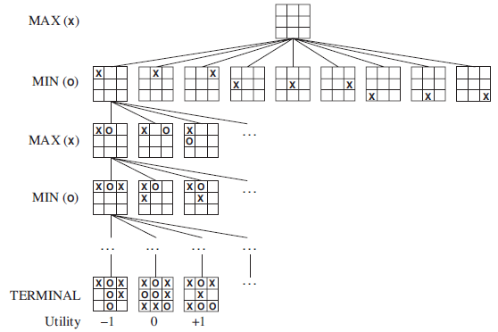
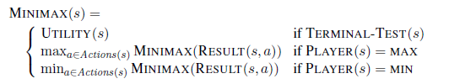
Tic-tac-toe—— example of Adversarial Search

Slide 51
Minimax algorithm
function MINIMAX-DECISION(state) returns an action
return argmax_{a∈ACTIONS(s)} MIN-VALUE(RESULT(state,a))
3
MIN
3
0
2
MAX
3
5
0
2
9
MIN
2
3
5
4
0
5
3
2
1
6
9

Slide 52
MIN-VALUE function
function MIN-VALUE(state) returns a utility value
if TERMINAL-TEST(state) then
return UTILITY(state)
v ←∞
for each a in ACTIONS(state) do
v ←MIN(v,MAX-VALUE(RESULT(s, a)))
return v
3
MIN
3
0
2
MAX
3
5
0
2
9
MIN
2
3
5
4
0
5
3
2
1
6
9

Slide 53
MAX-VALUE function
function MAX-VALUE(state) returns a utility value
if TERMINAL-TEST(state) then return UTILITY(state)
v ← −∞
for each a in ACTIONS(state) do
v ←MAX(v,MIN-VALUE(RESULT(s, a)))
return v
3
MIN
3
0
2
MAX
3
5
0
2
9
MIN
2
3
5
4
0
5
3
2
1
6
9

Slide 54
Estimate Minimax value of notes
it is sometimes difficult to reach leaf nodes in reasonable time
Using an estimating function to get MINIMAX VALUE for notes in possible depth
3
MIN
3
0
2
MAX
3
5
0
2
9
MIN
2
3
5
4
0
5
3
2
1
6
9

Slide 55
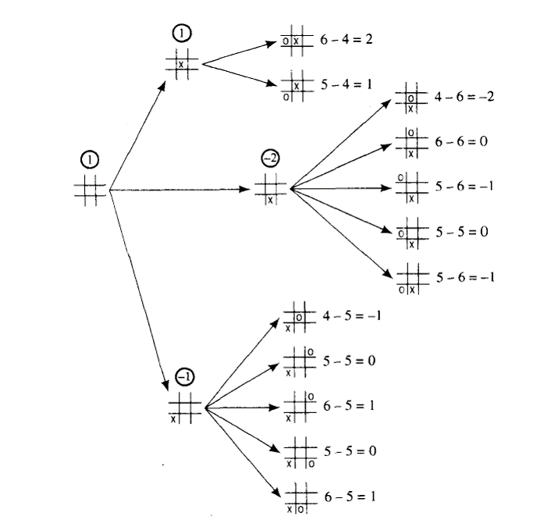
estimating MiniMax value in Tic-tac-toe
an estimating function
MINIMAX(s)
= (numbers of all possible lines to MAX)
–(numbers of all possible lines to MIN)
Utility(s) = ∞|-∞|0

Slide 56
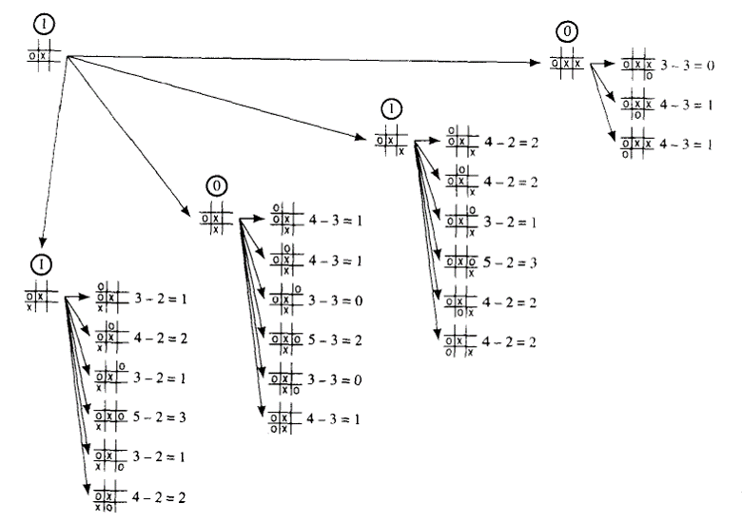
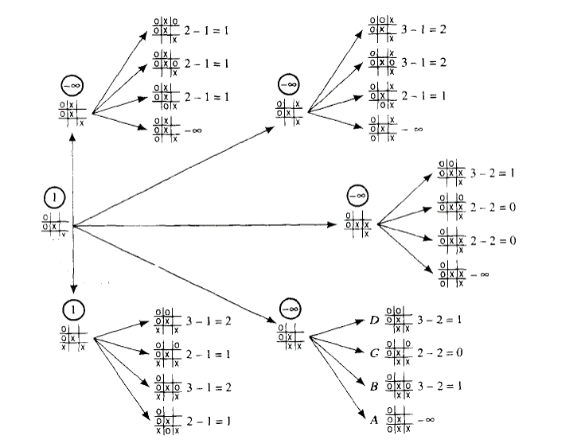
estimating MiniMax value in Tic-tac-toe ––continue

Slide 57
α-β pruning
Minimax algorithm :
For exponential in the depth of the tree, search is complex
α-β pruning :
To cut some parts of the search tree
to reduce search complexity
3
MIN
3
0
2
MAX
3
5
0
2
9
MIN
2
3
5
4
0
5
3
2
1
6
9

Slide 58
α-β prunning – an example
MAX
≥ 3
MIN
≤ 3
≤ 0
≤ 2
≥ 2
MAX
≥ 5
3
0
2
MIN
2
3
5
4
0
5
3
2
1
6
9

Slide 59
Reading for Review
Part 2 Chap 4 Beyond Classical Search
Local Search
Searching with nondeterministic actions
Searching with partial observations
Part 2 Chap 5 Adversarial Search
Optimal Decisions in Games
Alpha-Beta Pruning

Slide 60
Reading for the coming topic
Part 3 Chap 8 and 9
First-order-logic and inference in it

Slide 61

Wow AI !
Introduction to Artificial Intelligence – Lecture 01

Slide 62
Fields
AI is relevant to any intellectual task
General
Learning
Perception
…
Specific
Playing chess ( go chess, …)
Proving mathematical theorems
Writing poetry
Driving a car on a crowded street
Diagnosing disease
…

Slide 63
Different definitions
 | Thinking | Acting
Humanly | to make computers think ...Machines with minds | Machines perform functions like people do
Rationally | Computational models | Rational agent

Slide 64
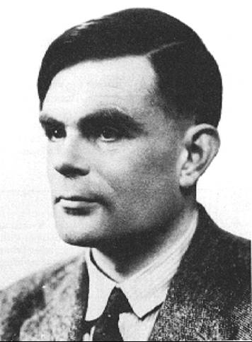

Acting humanly: Turing Test
to provide a satisfactory operational deﬁnition of intelligence(1950)
Conversation
Via online typed message
program and an interrogator
5 mins
Intelligence
Interrogator guesses if the conversation is with a program or a person
Passed if the program fools the interrogator

Slide 65
Acting humanly: computer need to possess :
natural language processing
to enable it to communicate successfully in English;
knowledge representation
to store what it knows or hears;
automated reasoning
to use the stored information to answer questions and to draw new conclusions;
machine learning
to adapt to new circumstances and to detect and extrapolate patterns

Slide 66
Acting humanly: total Turing Test
Turing’s test deliberately avoided direct physical interaction
the so-called total Turing Test
the interrogator can test the subject’s perceptual abilities through a video signal ;
To pass the total Turing Test, the computer will need :
computer vision to perceive objects,
robotics to manipulate objects and move about

Slide 67
AI: Weak vs. Strong
Weak AI
Can machines act intelligently ?
Strong AI
Can machines really think ?

Slide 68
The Foundations of Artificial Intelligence
Philosophy
Mathematics
Economics
Neuroscience
Psychology,
Computer engineering
Control theory and cybernetics
Linguistics

Slide 69
THE STATE OF THE ART
Robotic vehicles
Speech recognition
Autonomous planning and scheduling
Game playing
Spam ﬁghting,
Logistics planning
Robotics
Machine Translation

Slide 70
Something you need to know when you want to use AI methods
Introduction to Artificial Intelligence – Lecture 01

Slide 71
Intelligent Agent
Perception – Action Cycle

Slide 72
Terminology
1 Fully vs. Partially Observable
2 Deterministic vs. Stochastic
3 Discrete vs. Continuous
4 Benign vs. Adversarial

Slide 73
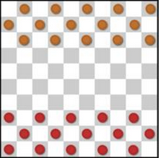
Quiz
☆ The Game of Checkers
☆ Poker
☆ Robotic car
answer
1 Fully or Partially Observable
2 Deterministic or Stochastic
3 Discrete or Continuous
4 Benign or Adversarial

Slide 74
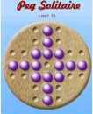
Q1 Peg solitaire
1 Fully or Partially Observable
2 Deterministic or Stochastic
3 Discrete or Continuous
4 Benign or Adversarial

Slide 75
Q2 Loaded Coin
fair coin or loaded coin
Loaded Coin：the probability of tail/head is not 50%
1 Fully or Partially Observable
2 Deterministic or Stochastic
3 Discrete or Continuous
4 Benign or Adversarial

Slide 76
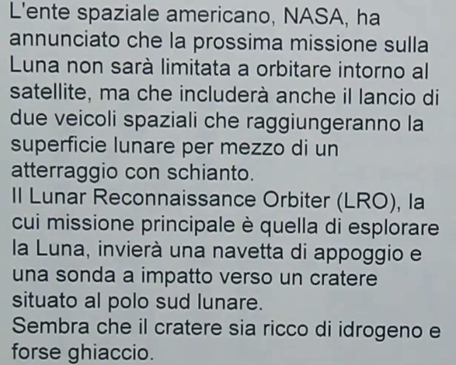
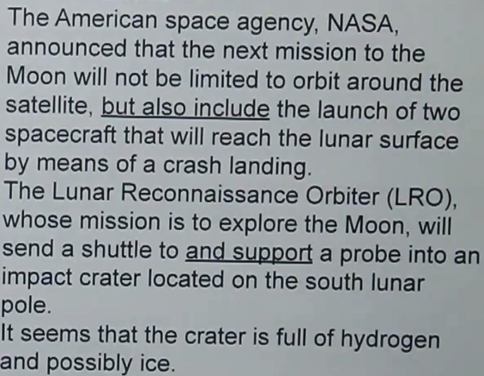
AI in Practice
Italian
English

Slide 77
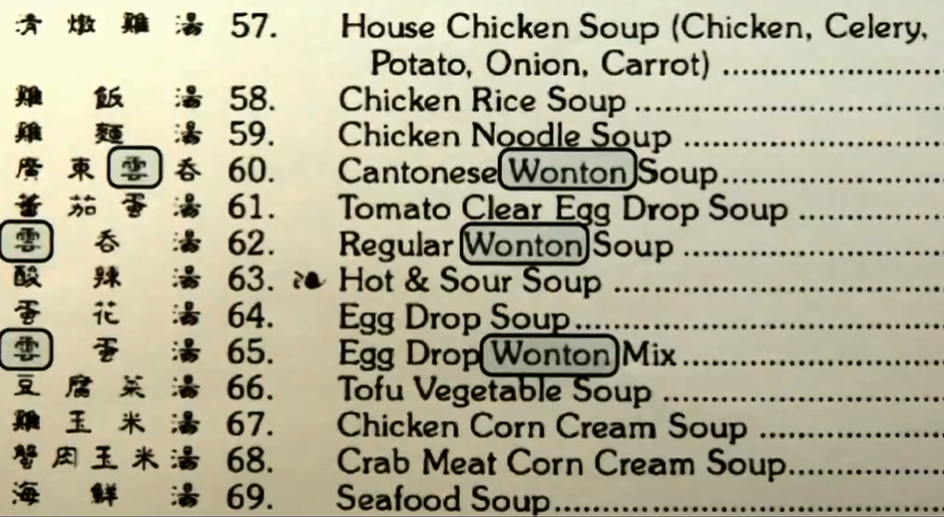
Menu – A simple version of Translation System

Slide 78
Questions
chicken
Corn cream
soup

Slide 79
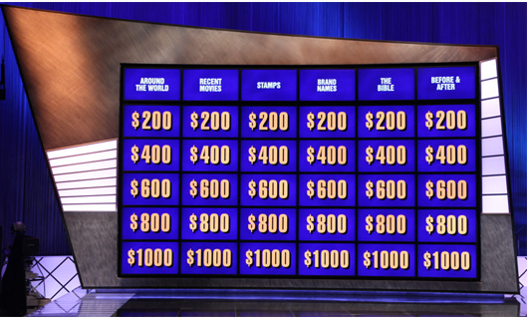
Watson - DeepQA
Watson is a computer system like no other ever built.
It analyzes natural language questions and content
well enough and fast enough
to compete and win against champion players
at Jeopardy
Jeopardy is a Quiz Show

Slide 80
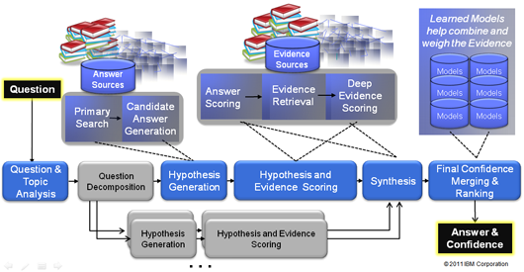
Watson’s answer process for question

Slide 81
Underlying Philosophy - DeepQA
No one program design from top to bottom will have all it needs to understand language
True intelligence will emerge from the development and integration of many different algorithms each looking at the data from different perspectives

Slide 82
DeepQA
With a question, DeepQA finds the important concepts and relations in the input language
Then it builds a representation of the user’s information need
Through search it generates many possible responses – Hypothesis
Evidence-based reasoning is used to score those hypothesis repeatedly
Final confidence merging and ranking before output the answer with confidence

Slide 83
Reading for Review
Part1 Chap1 Introduction
All about AI, foundation, History, State of Art
Part1 Chap2 Intelligent Agent
Good Behavior
Nature of Environments

Slide 84
Reading for the coming topic
Part2 Chap3 Solving Problems by Search
Heuristic Search
State Space

Slide 85
Thank You !

